Slide 1
Project title
Take away Self-Container in Colleges and Universities

Slide 2
Main objectives of the project
Let the takeaway and courier have a safer place to store goods when the students can't even take them. Let students have a convenient and safe cabinet to store and get things.

Slide 3
Usecase
UC-10:Close cabinet: The depositor puts the package and closes the door
UC-11:Cabinet occupancy mark: The data processing center marks that the cabinet has been used.
UC-12:Send pick-up code: The system receives the order information, and sends the pickup QR code to the id according to the order information.

Slide 4
UC-10:Close cabinet
Use Case UC-（10）Close own cabinet
Initiating Actor: Any of: recipients
Actor’s Goal: close the own cabinet
Participating Actors: cabinet, door of the cabinet, data processing center
Preconditions: Recipients got the food or takeout successfully.
Post conditions: The door is closed.
Flow of Events for Main Success Scenario: The recipients got the food and takeout. The system confirmed the behavior. The recipients need to close the door.

Slide 5
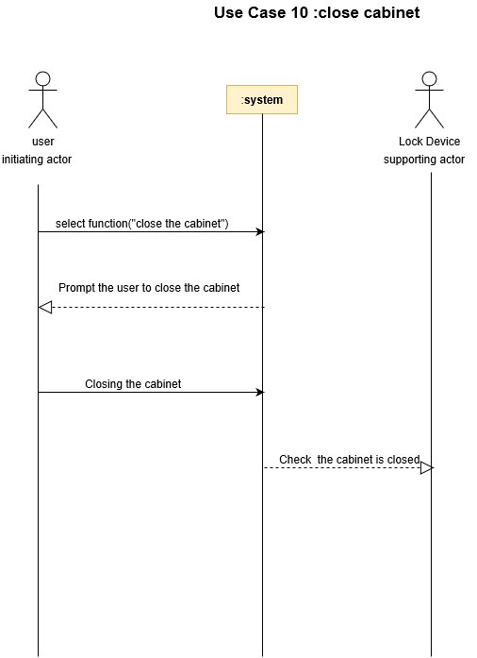
UC-10:Close cabinet

Slide 6
UC-11:Cabinet occupancy mark
Use Case UC-（11） Tag occupation of self-contained cabinets
Initiating Actor: Any of: senders, recipients, system
Actor’s Goal: the senders and recipients finished the behavior.
Participating Actors: data processing center, cabinets
Preconditions: The senders finished the behavior and close the door.
Post conditions: The cabinets tag the occupation.
Flow of Events for Main Success Scenario: The senders and recipients finished the process and close the door. The system confirmed the behavior and tag occupation of the cabinets

Slide 7
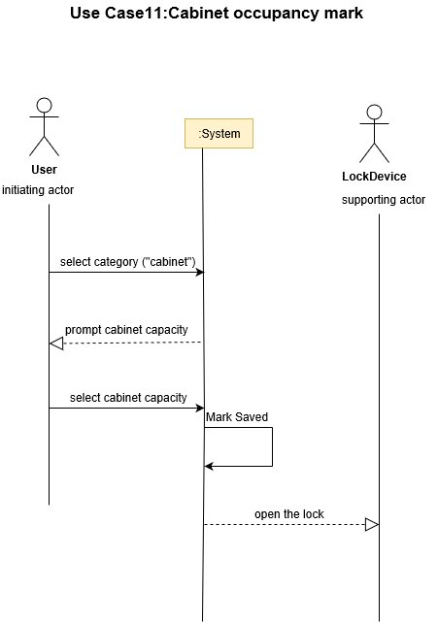
UC-11:Cabinet occupancy mark

Slide 8
UC-12:Send pick-up code
Use Case UC-（12）System sending the fetch code
Initiating Actor: System, fetching code
Actor’s Goal: Let users see their food or take-out information
Participating Actors: recipients, system, data processing center
Preconditions: System has received the successful order information, and sent the fetch code.
Post conditions: Recipients received the fetch code.
Flow of Events for Main Success Scenario: System saw the information and sent the fetch code; the recipients got the fetch code.

Slide 9
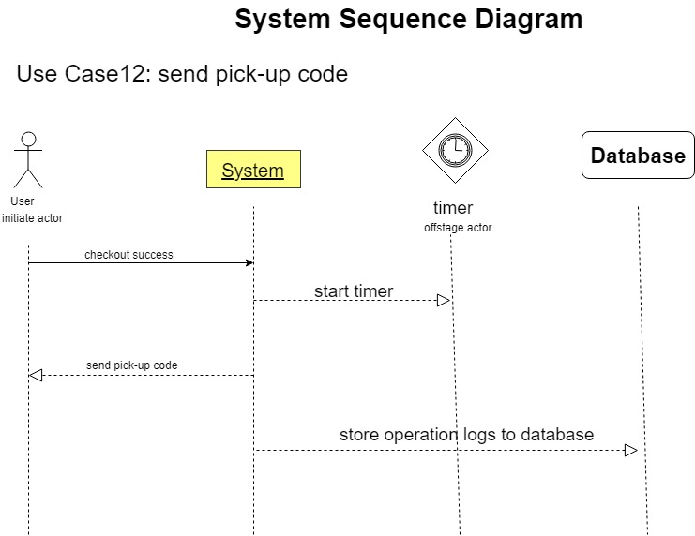
UC-12:Send pick-up code

Slide 10
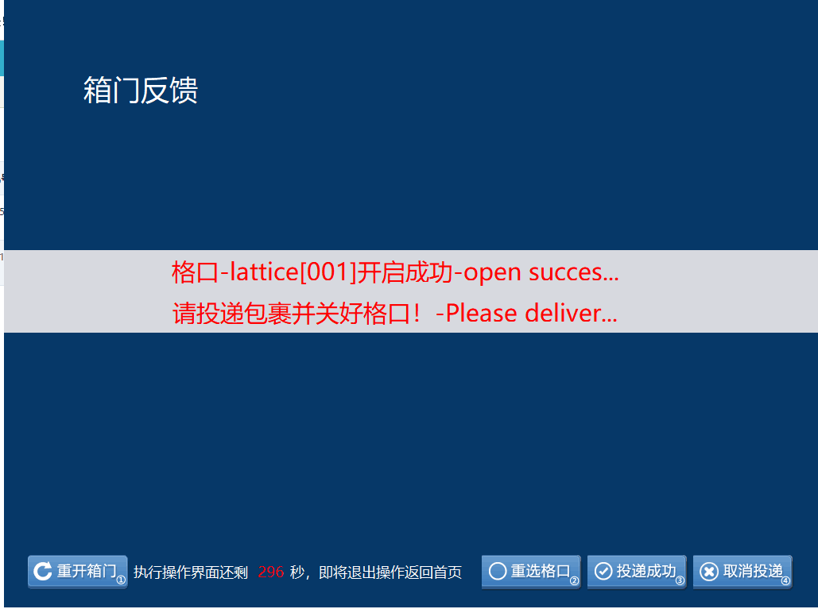
UC-12:Send pick-up code

